Slide 1

Game Jam Tools & Tricks
@MattPerrin
Slides: http://github.com/mattperrin

Slide 2
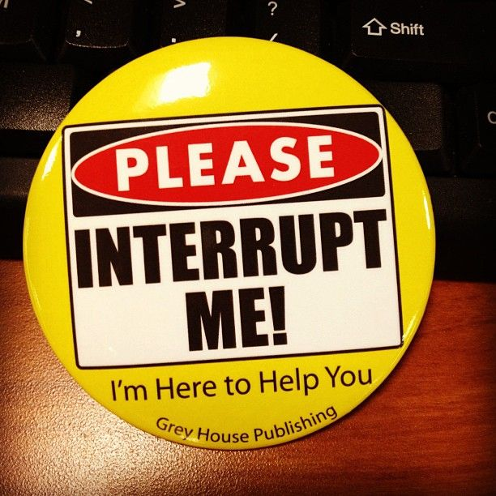

Slide 3

Who am I?
C# Developer / Test Lead at a major insurance company…
Terrible at art…
Kinda color-blind…
I fail more than I am successful…
I still love making games. ☺

Slide 4
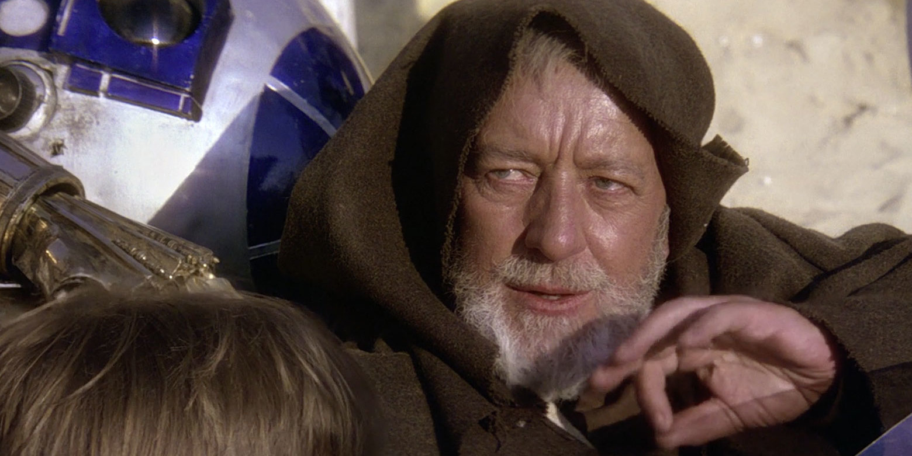

Slide 5
Self-doubt
Do I need a team…?
I usually work alone...
I don’t know anyone here…
What if my ideas are bad…?
What if I’m not good enough…?

Slide 6
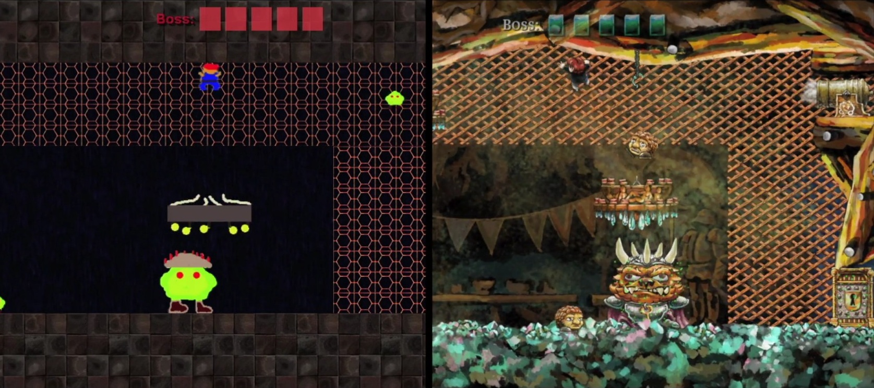

Slide 7
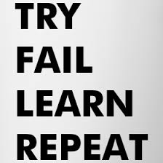
Finding Success
Set reasonable goals
Take care of yourself
Know your tools
Make it “pretty” later
Experiment
Failure is OKAY (and a good thing!)

Slide 8
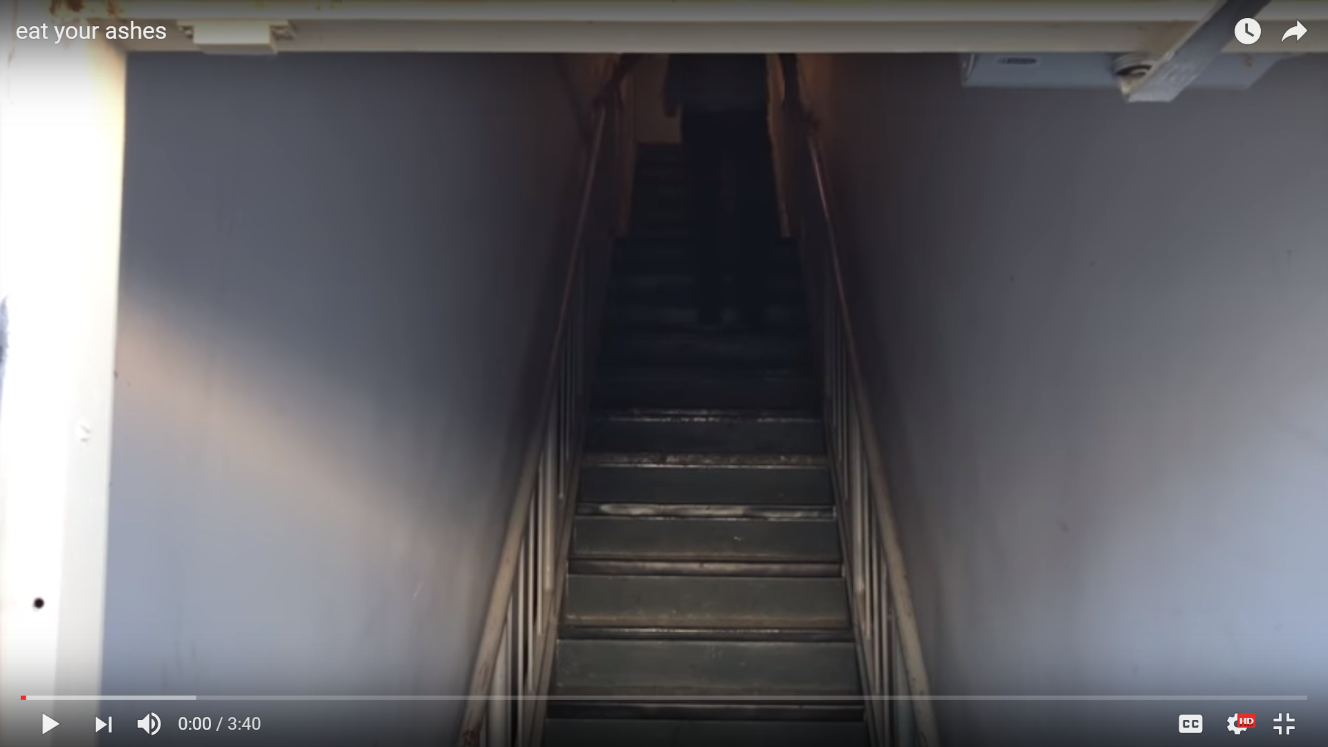
“Eat your ashes” (NSFW)
Max Landis (aka Uptomyknees)
https://www.youtube.com/watch?v=zfLPkK_XH7I
Doing is better than thinking
Burn your old ideas to find new ones
Failures are successes

Slide 9
Taking time to Experiment
"I love when a game is unafraid to really go for it with color. You don't realize how bland modern games are until someone goes punk." - Ben Kuchera "So every once in a while I erase all the whiteboards. Everybody gets mad, but then there's an explosion of new doodles!" - Tim Schafer, Double Fine Productions "The only way for the industry to push past the same old, same old is to create rapid prototypes and then expand on those that work. Valve uses this formula constantly." - David Rosen, Wolfire Games

Slide 10
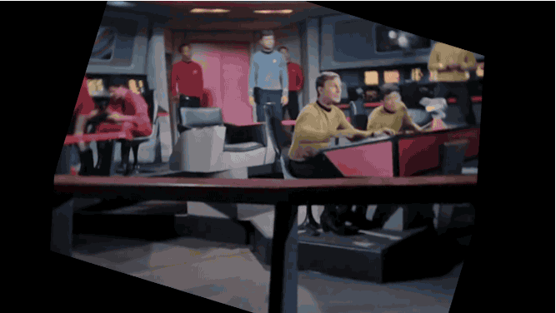
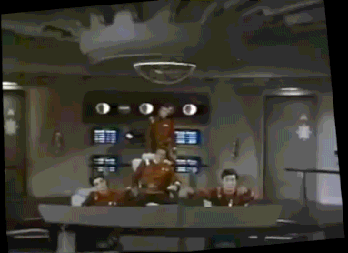
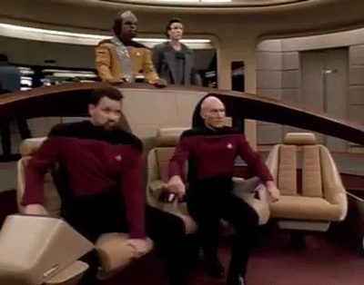
“JUICING”
Sound Effects!
Particle Effects!
Screen shake!
Tip: On every collision – Trigger something!

Slide 11
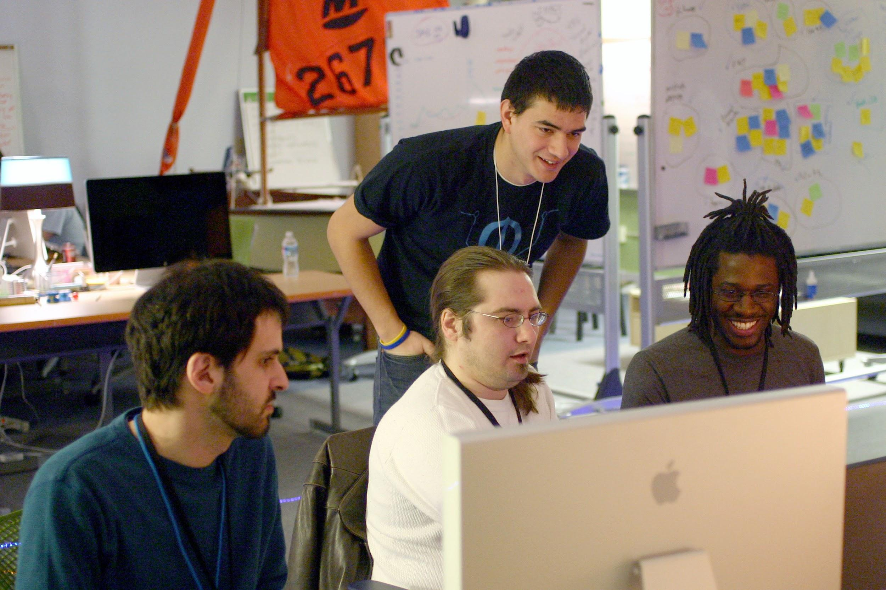
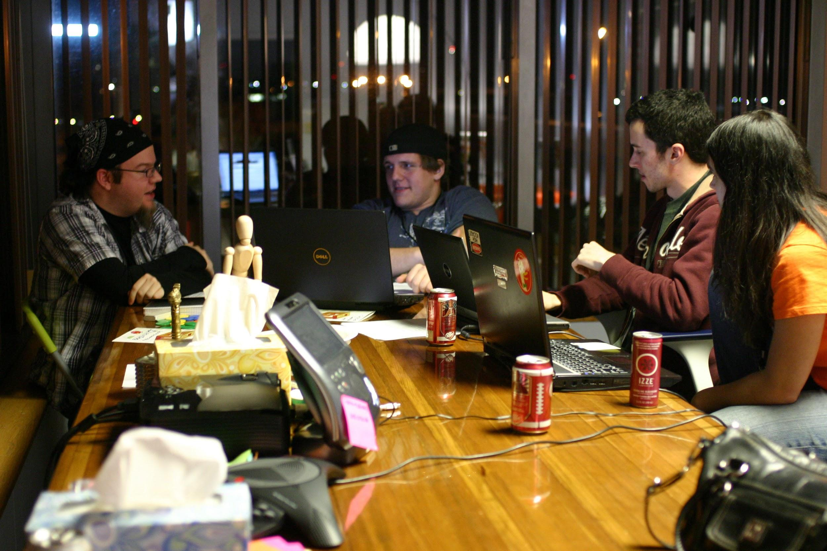
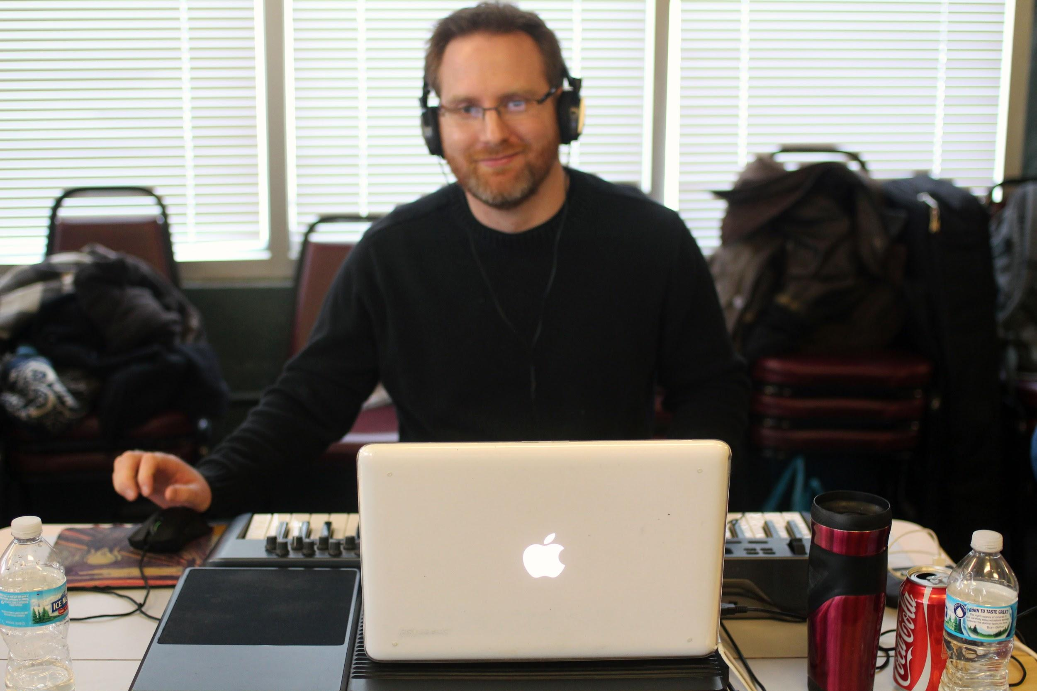
How can I Participate?
"Lone wolf" it
Pitch your own idea, start a team
Engage with others, ask to help out
"Freelance" across teams
Talk to an organizer for ideas

Slide 12
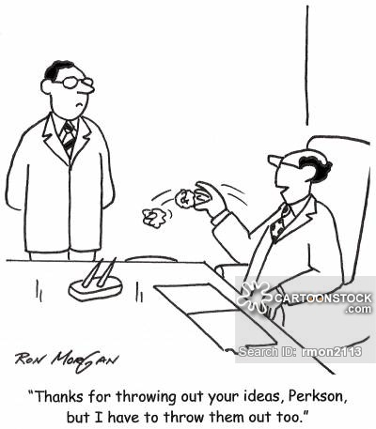
Approaching the Theme
The First Five Minutes
Pitching an Idea
Organizing your thoughts
And… Throwing away your first idea…

Slide 13
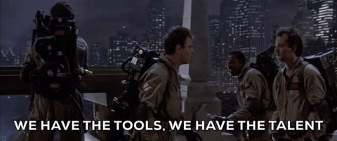

Slide 14
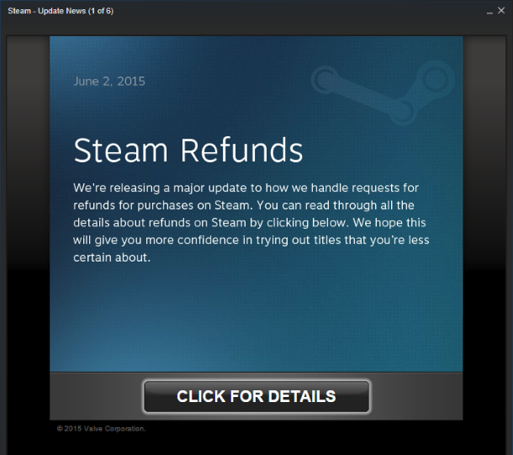

Slide 15
XMind
www.xmind.net
MindMapping
FREE! (With Pro version)
Win / Mac / Linux / Mobile (Cloud)
Alternative - FreeMind

Slide 16
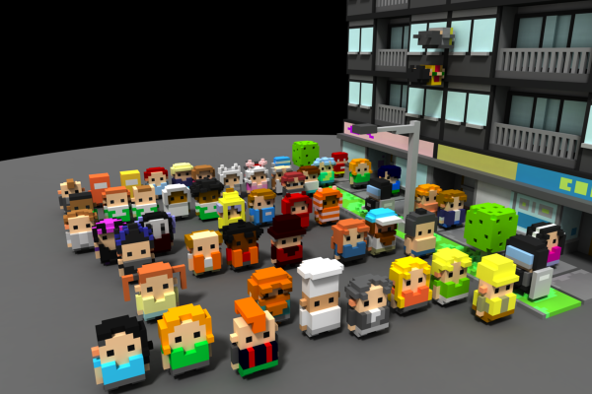
MagicaVoxel
https://ephtracy.github.io/
Voxel Model Editor
FREE!!!
Mini Mike's Metro Minis
(400 voxel models)
https://mikelovesrobots.github.io/mmmm/

Slide 17
Mixamo
www.mixamo.com
3D Model Rigging and Assets
FREE!!! (But for how much longer…?)
https://www.mixamo.com/
https://www.mixamo.com/workflows/unity

Slide 18
SketchUp
http://www.sketchup.com/
3D Modeling
FREE! (With Pro version)
Owned by Google
Good documentation
Tutorials
Little bit funky to learn (anything’s better than Blender)

Slide 19
NormalMap-Online
http://cpetry.github.io/NormalMap-Online/
Normal maps (aka bump maps) for illumination
FREE!!!

Slide 20
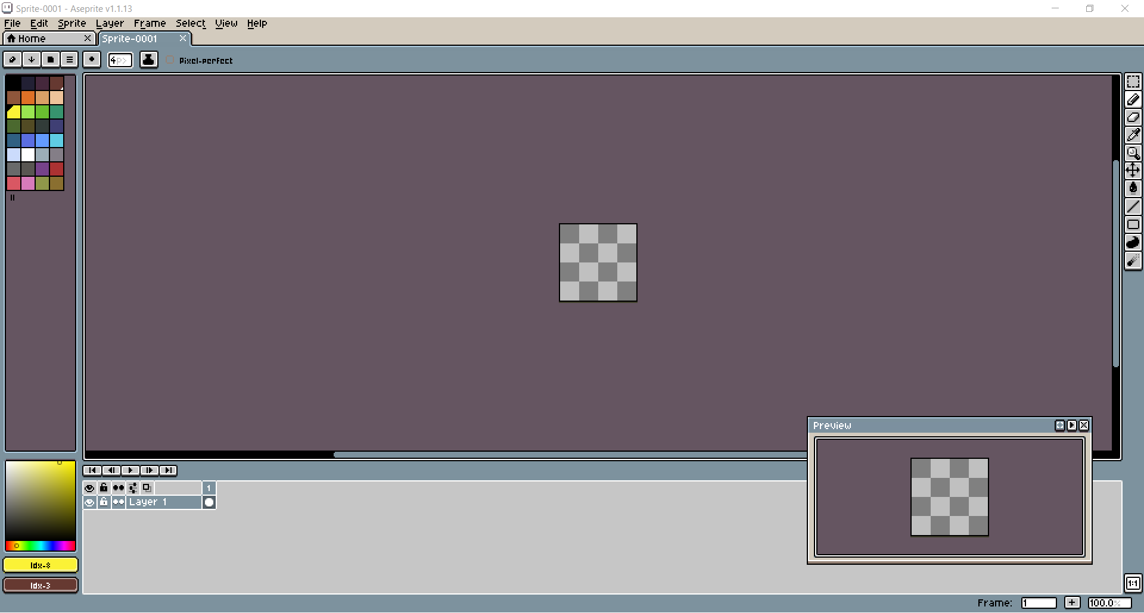
Aseprite
www.aseprite.org
Pixel art & sprite sheet editor
$15 ($12 on Steam Sale)
Unity Animation Plug-In (?)
https://github.com/talecrafter/AnimationImporter

Slide 21
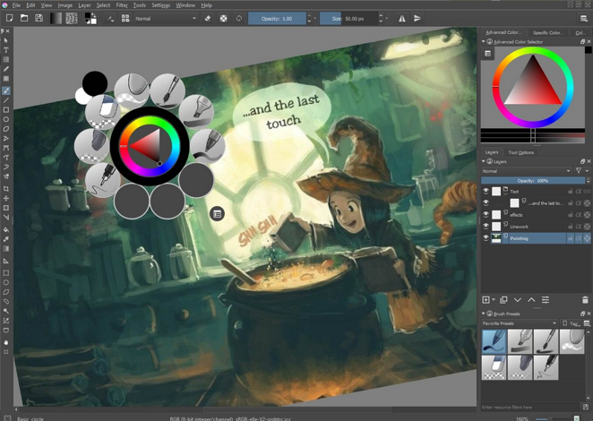
Krita
https://krita.org
FREE!!!
Photoshop clone
Lots of brushes
Powerful (with practice)

Slide 22
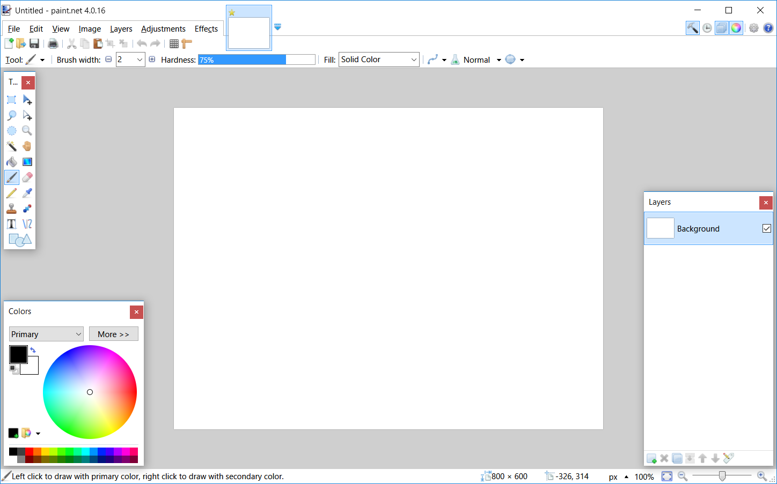
Paint.Net
www.getpaint.net
Graphic Editor
FREE!!!
Free Alternatives:
GraphicsGale
MS Paint

Slide 23
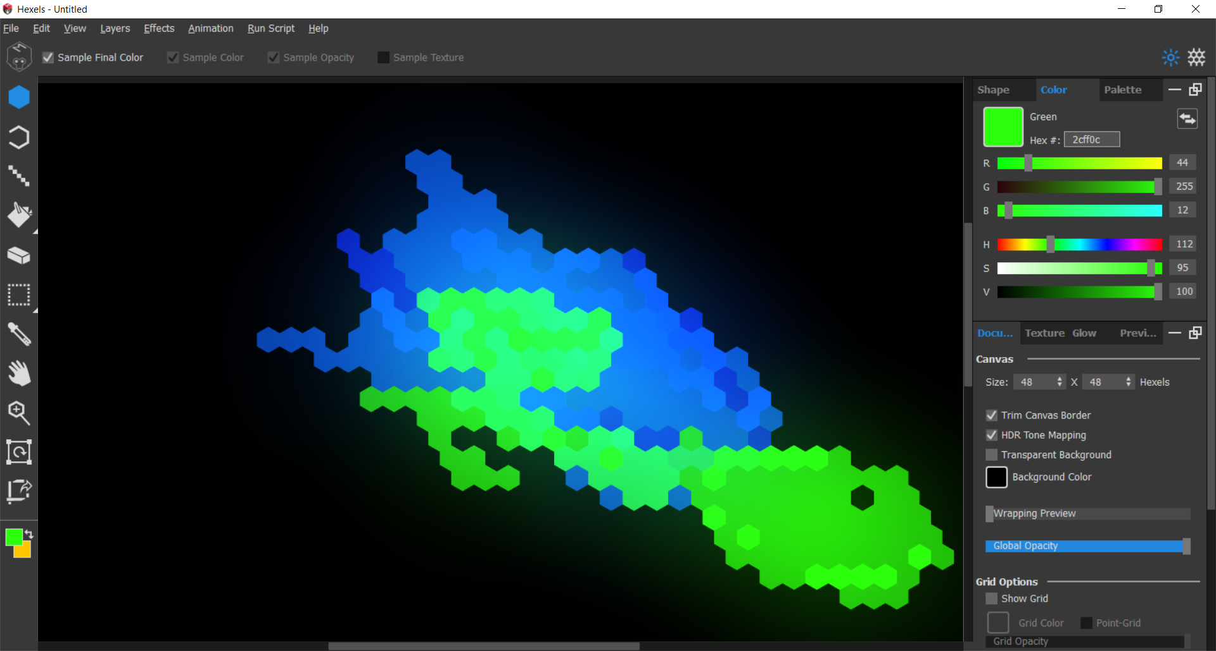
Hexels 2
www.marmoset.co/hexels/
Marmoset Hexels 2
$38 ($19 during Steam sale)
Kind of a cool / funky 2D editor

Slide 24
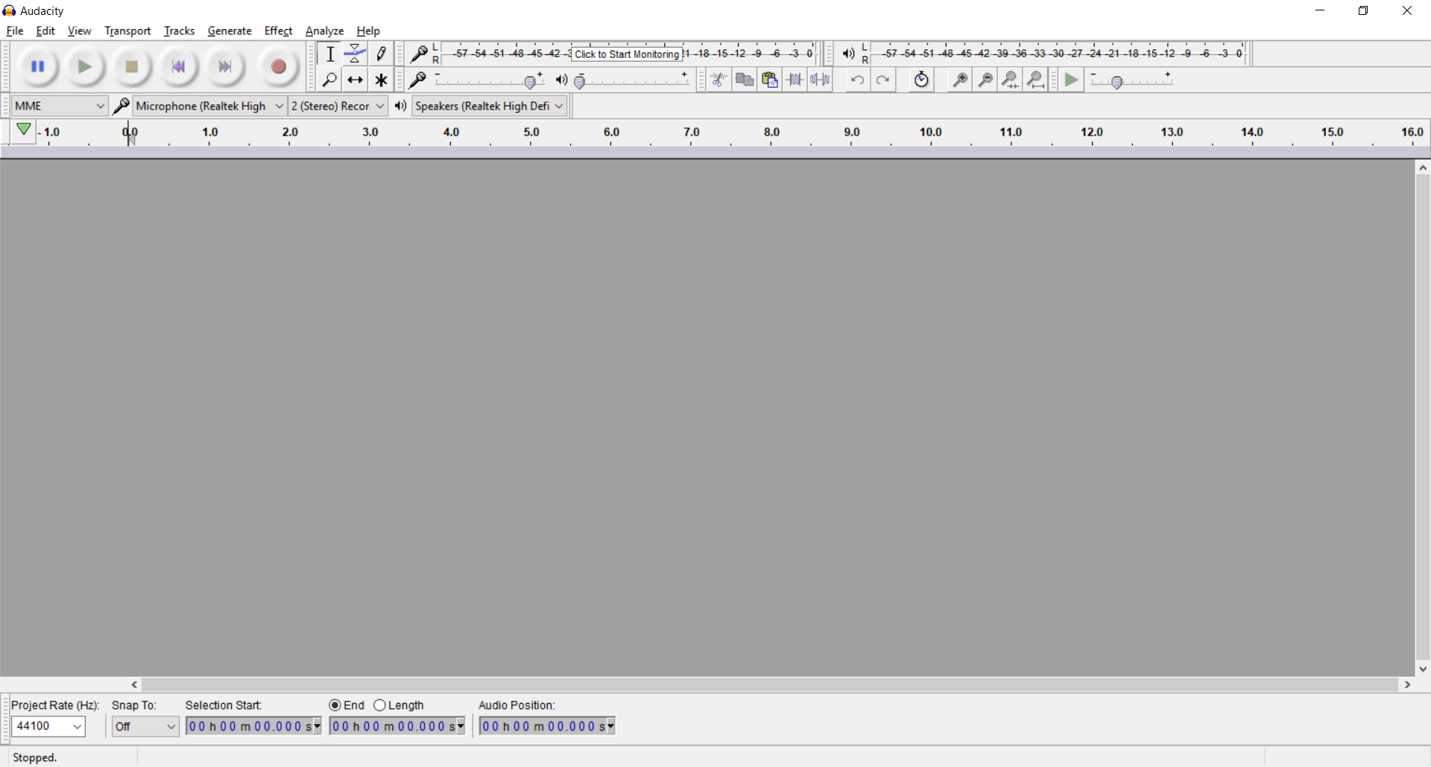
Audacity
Sound editor / recorder
FREE!!!

Slide 25
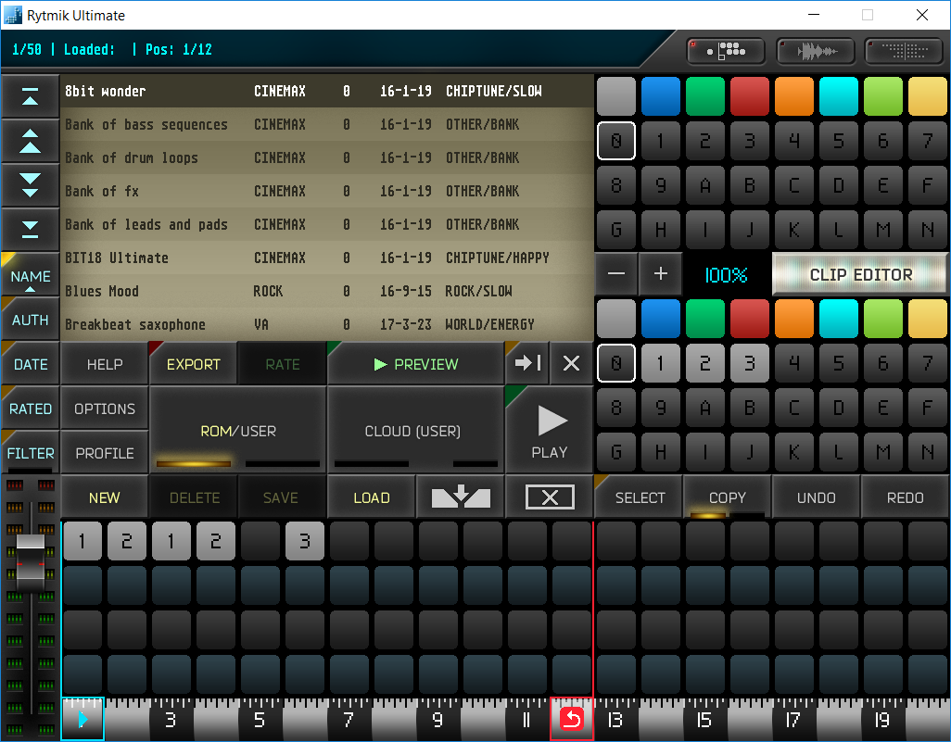
Rytmik Complete
$30 ($13 on Steam Sale)
Chiptune / Sample sequencer
Great online tutorials…
Not so great interface

Slide 26
Github Desktop
https://desktop.github.com/
FREE!!! (BUT… it’s public..)
Not just for source control
Free website hosting at github.io

Slide 27
Other things and ideas…
OBS – Not Just for Twitch
HitFilm Express
https://twitter.com/chriswade__/status/881094385483608065

Slide 28
Alternative Game Engines
Twine – HTML / JS – Narrative Games (Choose Your Own Adventures)
http://twinery.org
Pico 8 – LUA – Retro inspired console
https://www.lexaloffle.com/pico-8.php
Phaser – HTML / JS – Browser & mobile games
https://phaser.io/
Construct 2/3
https://www.scirra.com/
Scratch – Drag & Drop – Browser games
https://scratch.mit.edu

Slide 29
Honorable Mentions
Spriter
$60 ($30 on Steam sale)
AMAZING sprite animator…
Complex, feature rich, COMPLICATED…
AssetForge
http://assetforge.io
$20 ($40 Deluxe)
3D Block based modeler
Coming Soon…? (First week of July)

Slide 30
Any Questions?
Twitter: @MattPerrin
Slides: http://github.com/mattperrin
"Okay, for me, first of all, dopeness is what I like the most. Dopeness. People who want to make things as dope as possible.” - Kayne West

